Slide 1

MLB Stolen Bases: Strategy, Records, and Impact on the Game
Exploring techniques and effects on baseball dynamics
Notes:
AI-generated content may be incorrect. --- This presentation explores the fascinating world of stolen bases in Major League Baseball (MLB). We will look at the history, techniques, notable players, and the impact of stolen bases on the game, alongside modern trends and future prospects.

Slide 2
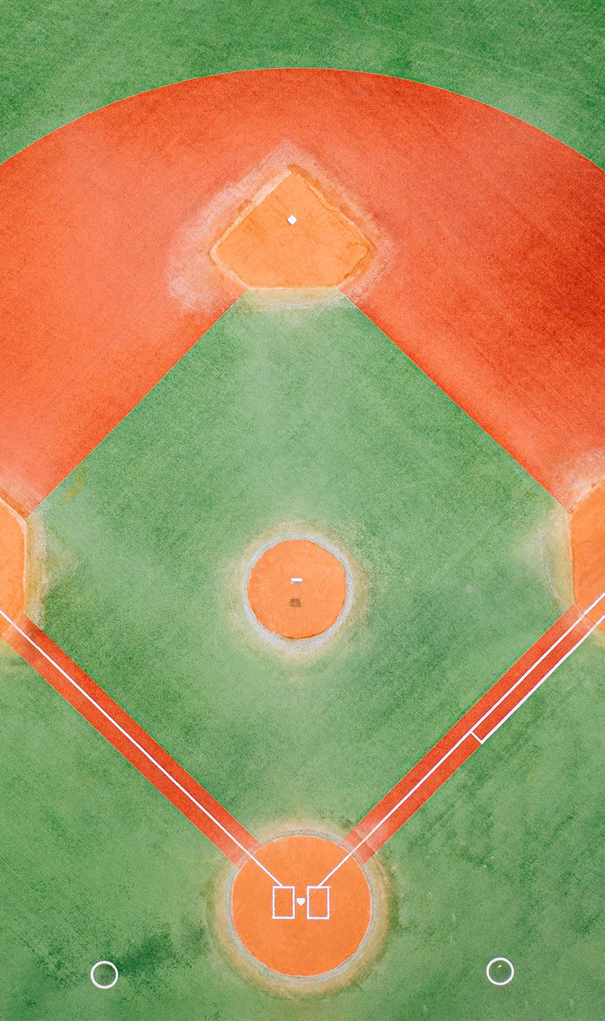
Agenda Items
History of Stolen Bases in MLB
Techniques and Strategies
Notable Players and Records
Impact on the Game
Modern Trends and Future Prospects
Notes:
In this presentation, we will cover the history of stolen bases in MLB, examining its origins, evolution, and key milestones. We will also discuss the techniques and strategies involved in stealing bases, as well as notable players and records that have shaped the game. Finally, we will analyze the impact of stolen bases on game dynamics and look at modern trends.

Slide 3
History of Stolen Bases in MLB
Notes:
The history of stolen bases in MLB showcases how the rule evolved over time and the strategies that emerged as the game developed. Understanding this history provides insight into the significance of stolen bases in baseball.

Slide 4

Origins of the Stolen Base Rule
Historical Context
The concept of stealing bases emerged in the late 19th century as players sought strategic advantages in baseball.
Strategic Advantage
Players realized that advancing bases could significantly improve their chances of scoring, adding a layer of strategy to the game.
Rule Establishment
The official stolen base rule was established to promote dynamic play and enhance the excitement of the game.
Notes:
The concept of a stolen base dates back to the late 19th century when players began to realize the strategic advantage of advancing bases. The official rule was established to encourage dynamic play and excitement in the game.

Slide 5

Evolution of the Strategy
Historical Strategies
The strategies for stolen bases have evolved significantly as the game of baseball has changed over the years, adapting to new challenges.
Importance of Speed
Teams now prioritize speed and agility in players, recognizing these traits as crucial for successfully stealing bases.
Sophisticated Tactics
Developing sophisticated tactics has become essential for maximizing the chances of success when attempting to steal bases in modern baseball.
Notes:
As baseball evolved, so did the strategies surrounding stolen bases. Teams began to prioritize speed and agility, developing sophisticated tactics to maximize their chances of success when attempting to steal bases.

Slide 6

Historical Milestones and Memorable Moments
Record-Breaking Performances
Several players have set records for stolen bases, showcasing their speed and tactical prowess on the field.
Unforgettable Moments
Memorable moments in baseball history have highlighted thrilling stolen bases that left fans in awe and excitement.
The Thrill of the Steal
The excitement of stealing a base adds intense drama to the game, captivating fans and creating unforgettable experiences.
Notes:
There have been many key milestones in the history of stolen bases, including record-breaking performances and unforgettable moments that have captivated fans and showcased the thrill of the steal.

Slide 7
Techniques and Strategies
Notes:
Stealing a base requires skill, timing, and strategic planning. This section will delve into the techniques and strategies used by successful base stealers, as well as how defensive teams can counter these attempts.

Slide 8
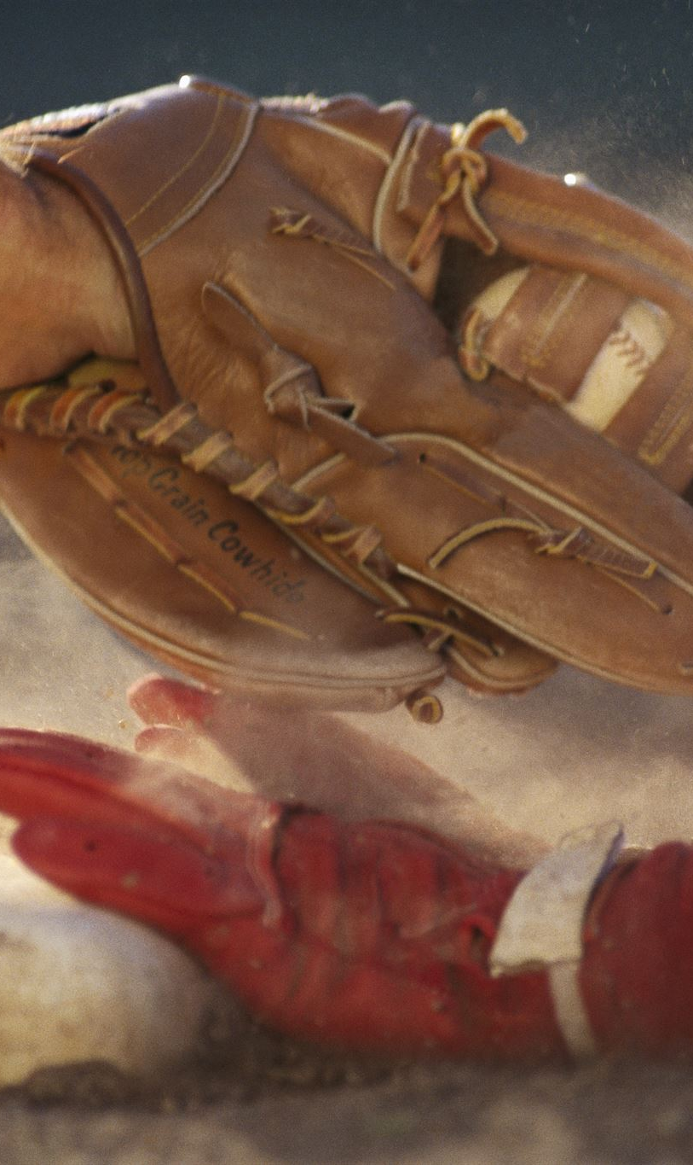
Basics of Stealing a Base
Reading the Pitcher and Catcher
Successful base stealing starts with observing the pitcher and catcher to anticipate their movements and reactions.
Taking an Aggressive Lead
An aggressive lead off the base is crucial for increasing the chances of a successful steal. It requires confidence and good judgment.
Quick and Powerful Sprint
Timing and speed are essential when making the sprint towards the next base. A powerful start can make a significant difference.
Notes:
The basic principles of stealing a base include reading the pitcher and catcher, taking an aggressive lead, and making a quick and powerful sprint towards the next base. Timing and anticipation are critical.

Slide 9

Key Techniques Used by Successful Base Stealers
Varying Lead Distance
Successful base stealers adjust their lead distance to keep pitchers guessing and create opportunities for stealing bases.
Deceptive Movements
Using deceptive movements, base stealers can trick the pitcher and infielders, increasing their chances of a successful steal.
Capitalizing on Pitchers’ Tendencies
Successful base stealers study pitchers' habits to exploit their weaknesses, timing their steals perfectly.
Notes:
Successful base stealers employ various techniques, such as varying their lead distance, using deceptive movements, and capitalizing on pitchers’ tendencies. These skills enable them to steal bases effectively.

Slide 10

Defensive Strategies to Prevent Stolen Bases
Holding Runners on Base
Defensive teams can effectively hold runners on base by using techniques like positioning and maintaining a strong presence, making it harder for them to steal.
Using Slide Steps
Pitchers can use slide steps to quicken their delivery, reducing the time runners have to steal bases and enhancing overall defense.
Employing Pitchouts
Pitchouts are strategic pitches thrown outside the strike zone, allowing catchers to throw out runners attempting to steal bases effectively.
Notes:
Defensive teams can implement several strategies to prevent stolen bases, including holding runners on base, using slide steps, and employing pitchouts. These tactics are essential for mitigating the threat posed by fast runners.

Slide 11
Notable Players and Records
Notes:
The legacy of stolen bases is defined by extraordinary players who have set records and redefined the art of base stealing. This section highlights some of the top base stealers in MLB history.

Slide 12
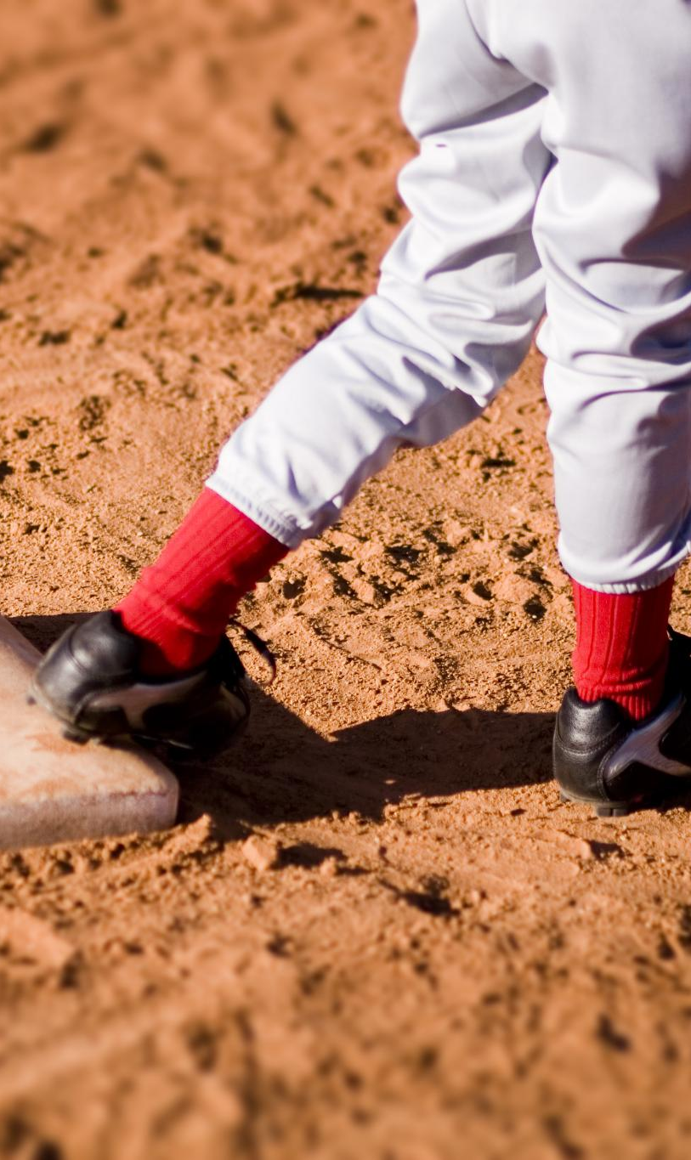
Top Base Stealers in MLB History
Ricky Henderson's Legacy
Ricky Henderson is widely regarded as the greatest base stealer in MLB history, holding the record for most stolen bases.
Lou Brock's Impact
Lou Brock was renowned for his speed and base-stealing prowess, significantly contributing to the St. Louis Cardinals' success.
Ty Cobb's Speed
Ty Cobb was known for his aggressive style and exceptional speed, making him one of the top base stealers of his era.
Notes:
Players like Ricky Henderson, Lou Brock, and Ty Cobb are celebrated for their remarkable speed and ability to steal bases, leaving an indelible mark on the game's history.

Slide 13

Record-Breaking Performances
Individual Player Impact
Record-breaking performances highlight how individual players can significantly influence the game and inspire their teammates.
Fan Excitement
Exceptional performances not only elevate the game but also create unforgettable experiences for fans, enhancing their connection to the sport.
Notes:
Record-breaking performances, such as Ricky Henderson’s all-time stolen base record, illustrate the impact that individual players can have on the game and the excitement they bring to fans.

Slide 14
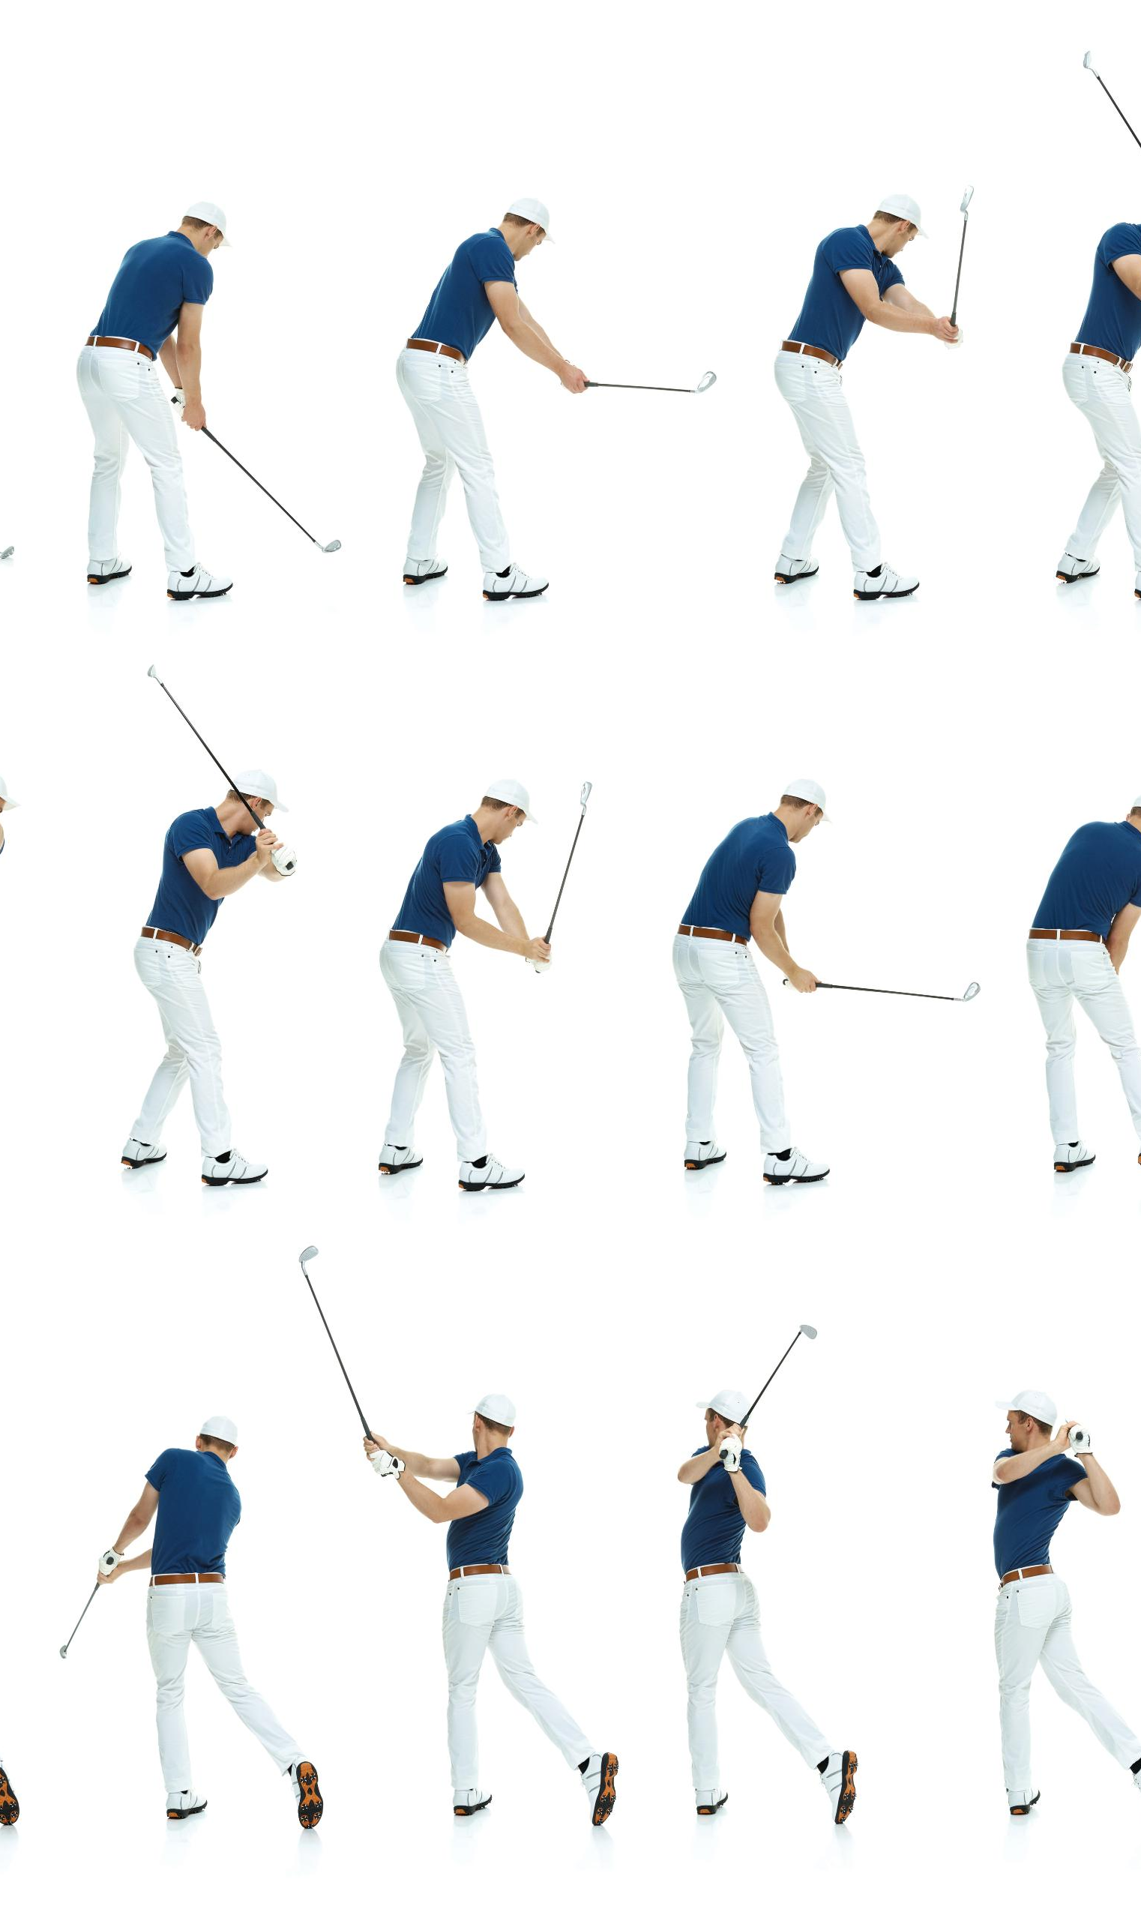
Profiles of Legendary Base Stealers
Playing Styles
Legendary base stealers have unique playing styles that combine speed, agility, and strategic thinking on the field.
Career Highlights
Throughout their careers, these players achieved significant milestones, setting records and thrilling fans with their base stealing prowess.
Contributions to Baseball
These players transformed the game by emphasizing the importance of speed and strategy in base stealing, influencing future generations.
Notes:
This segment provides profiles of legendary base stealers, discussing their playing styles, career highlights, and contributions to the game of baseball.

Slide 15
Impact on the Game
Notes:
Stolen bases significantly influence game outcomes and team strategies. This section examines how base-stealing impacts tactical planning and the overall dynamics of a baseball game.

Slide 16
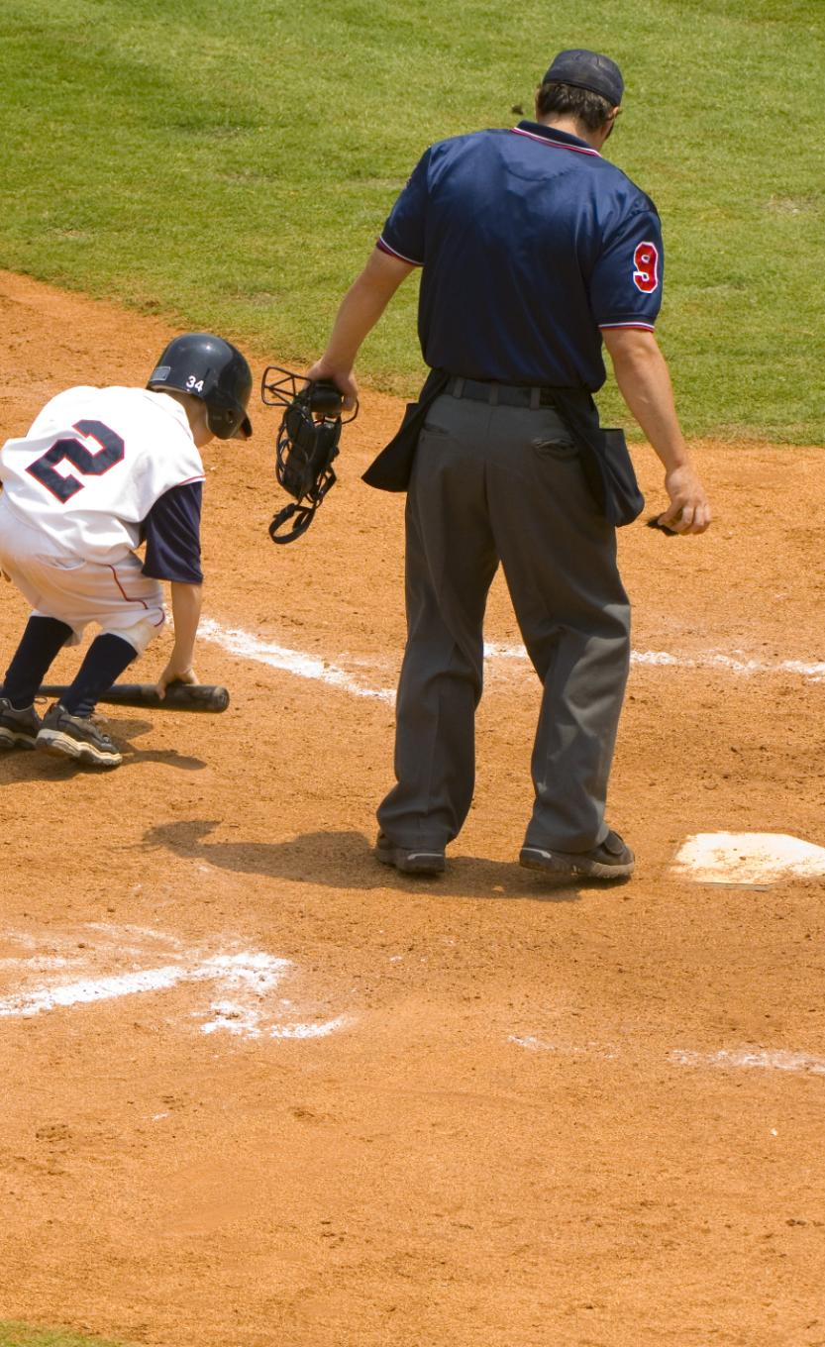
Influence on Game Outcomes
Momentum Shift
Stealing bases can significantly shift the momentum in a baseball game, creating new scoring opportunities for the team.
Strategic Impact
The threat of stolen bases forces pitchers to alter their strategies, often leading to more favorable matchups for batters.
Close Game Dynamics
In close games, the ability to steal bases becomes even more critical, potentially determining the game's outcome.
Notes:
The ability to steal bases can shift momentum in a game, leading to increased scoring opportunities and altering pitchers' strategies. This impact can be critical in close games.

Slide 17

Effect on Team Strategies and Planning
Incorporating Base-Stealers
Effective teams strategically incorporate base-stealers to enhance their overall game strategy, improving scoring opportunities.
Risk and Reward Balance
Teams must assess the risks and rewards of stealing bases, adapting to different game situations and defensive setups.
Game Situations Analysis
Analyzing specific game situations allows teams to make informed decisions regarding base-stealing opportunities.
Notes:
Teams must incorporate base-stealers into their overall strategies, balancing the risk and reward of attempting to steal bases based on game situations and opposing defenses.

Slide 18

Fan Perspectives and Excitement
Excitement of Stolen Bases
Stolen bases create thrilling moments that excite fans and heighten the competitive atmosphere during games.
Atmosphere in the Ballpark
The successful execution of a stolen base can electrify the crowd and enhance the overall ballpark experience.
Notes:
Stolen bases generate excitement among fans and can create electrifying moments in games. The thrill of a successful steal often amplifies the atmosphere in the ballpark.

Slide 19
Modern Trends and Future Prospects
Notes:
As the game evolves, so do the trends in stolen bases. This section discusses current trends, the impact of technology, and future potential changes in MLB rules regarding base stealing.

Slide 20

Current Trends in Stolen Bases
Shift in Strategy
Recent seasons reveal teams either embracing or avoiding stolen bases as part of their gameplay strategy.
Frequency Changes
An analysis of how the frequency of stolen bases has evolved over recent seasons, showing notable fluctuations.
Future Predictions
Understanding current trends is key to predicting future developments in stolen base strategies and team dynamics.
Notes:
Recent seasons have shown a shift in the frequency of stolen bases, with teams either embracing or shying away from this strategy. Understanding these trends is crucial for predicting future developments.

Slide 21

Technological Advancements and Analysis
Video Analysis Technology
Video analysis technology provides teams with a detailed look at gameplay, enhancing their strategies for stolen bases.
Player Tracking Systems
Player tracking systems offer real-time data on player movements, contributing to better decision-making in stealing bases.
Enhanced Performance Insights
These technological advancements provide valuable insights that can enhance player performance and overall team strategies.
Notes:
Advancements in technology, such as video analysis and player tracking, are revolutionizing how teams approach stolen bases, providing insights that can enhance performance.

Slide 22
Future Potential and Changes in MLB Rules
Impact on Stealing Bases
Proposed changes in MLB rules could significantly affect the strategies around stealing bases, altering gameplay dynamics.
Modifications to Pitching Rules
Changes to pitching rules are under discussion, which could influence pitcher behavior and batter strategies.
Base Size Adjustments
Adjustments to base sizes are being considered, which could impact runners' speed and safety on the field.
Notes:
There is ongoing discussion about potential rule changes in MLB that could impact the strategy of stealing bases, including modifications to pitching rules and base sizes. These changes could reshape how the game is played.

Slide 23
Conclusion
Thrill of Stolen Bases
Stolen bases add excitement and strategic depth to Major League Baseball, keeping fans engaged throughout the game.
Evolving Strategies
As the game evolves, so do the strategies surrounding stolen bases, making it an essential element of gameplay.
Future of Stolen Bases
With advancements in technology and analytics, stolen bases will continue to shape the dynamics of MLB games.
Notes:
Stolen bases are a thrilling and strategic component of MLB, influencing game dynamics and fostering excitement among fans. As strategies evolve and technology advances, the future of stolen bases promises to be as engaging as its rich history.

